Slide 1

Group 11
Presented by:
Marc Burrell EE/CpE Mario Martinez EE Geoffrey Mulberry EE
Sponsored by Dr. Kim
Portable PCR Machine

Slide 2
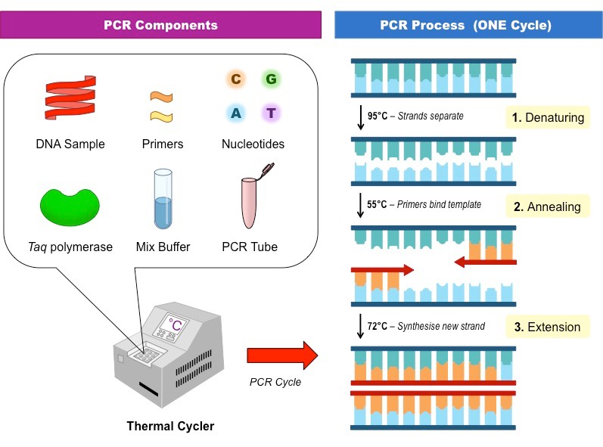
What is PCR?
PCR stands for Polymerase Chain Reaction
PCR is a technique that is able to amplify a gene or DNA sequence multiple times

Slide 3
Motivation
Current PCR machines are very large and bulky
Outbreaks
Portable for use in field
Samples tested on sight, less contamination
GPS in portable PCR would allow for automatic geographic tracking of outbreaks
Phone app to allow easier access of data among the science community

Slide 4
Overview
Two heating Elements at set temperatures
Servos
LED, Emission Filter, and Photodiode
Touch Screen
Rechargeable Battery
GPS
Bluetooth
Phone App for our device
Online Database

Slide 5
Design Specifications
Heating and Cooling: | Must be able to heat up to 95C and cool to 60C
Location: | Using GPS must be able to determine location +/- 100m accuracy
Wireless Communication: | Must be able to transmit all data via wireless technology to a mobile device (WiFi, Bluetooth, ect.)
Optical Filtering: | Detecting 518 nm wavelength
Weight: | < 7.5 lbs
Cost: | < $500
App integration: | Must be able to communicate data to the app, display its results, and be controlled by the app
Dimensions: | < 64 inches squared

Slide 6
Safety
Our device is meant to be dealing with different viruses such as HIV and need our machine to be dealt with care
PCR tubes carry the physical content
Therefore the machine itself must support the users who are handling such content
We have designed our device to be operated by someone who is wearing gloves

Slide 7
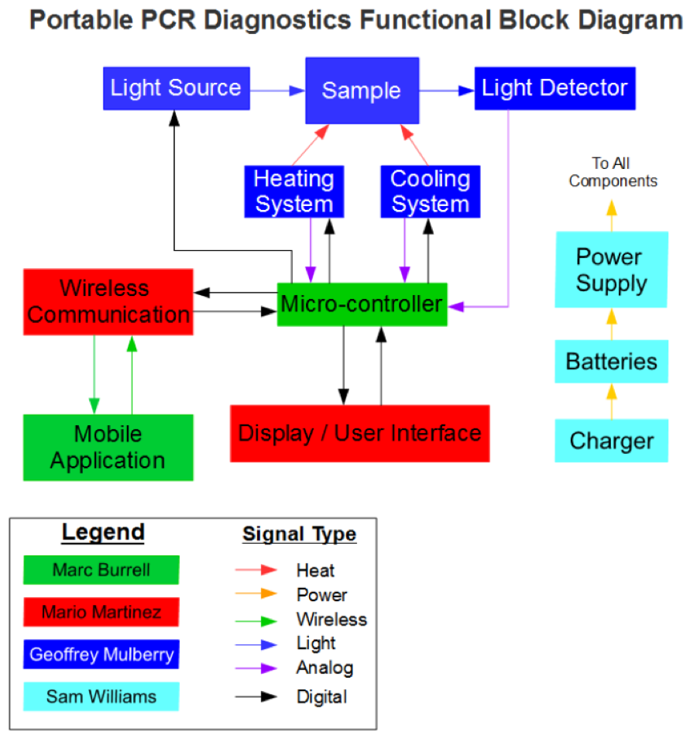
Block Diagram / Work Distribution
Mario
Sam Williams left our group and his portion of the project has been divided among the three of us

Slide 8
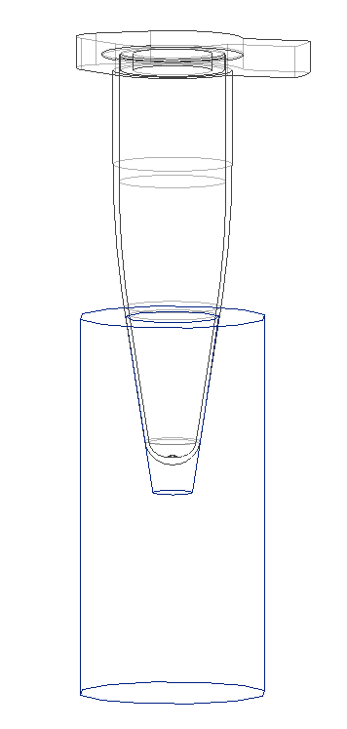
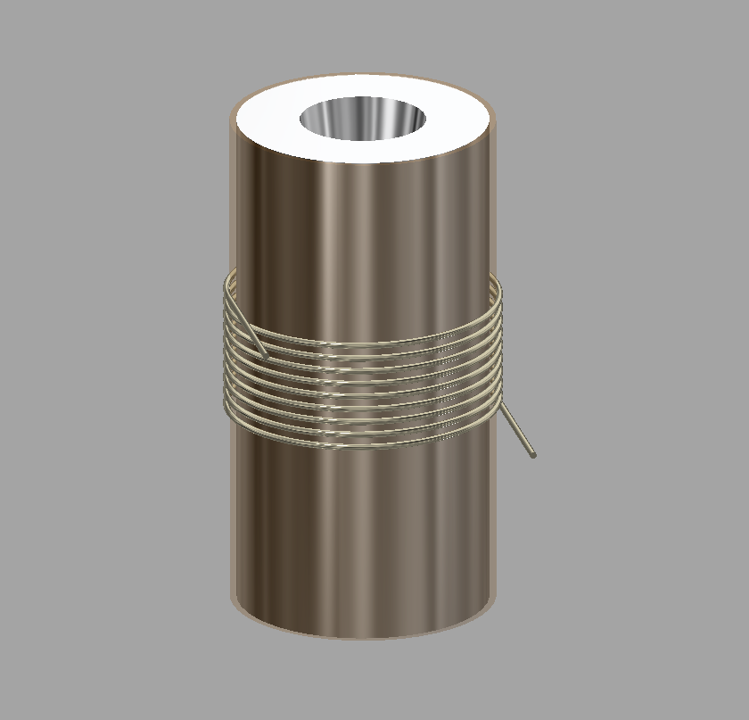
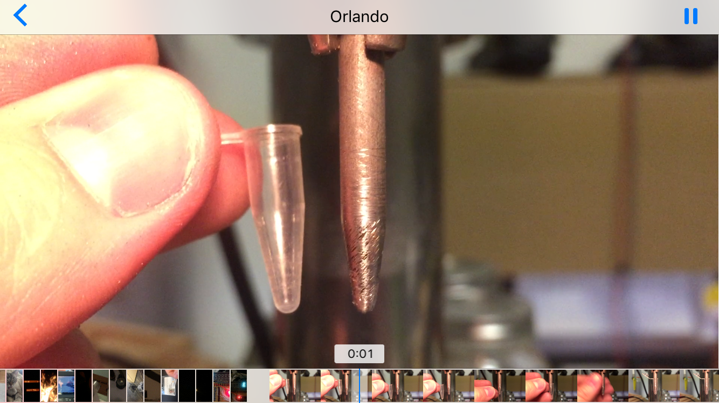
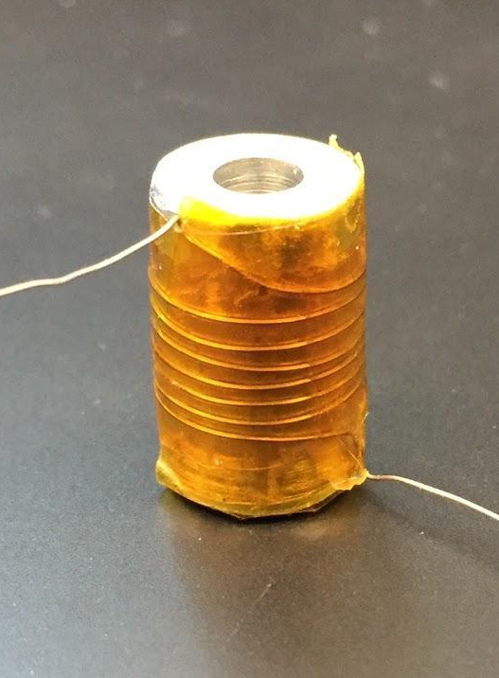
Heating Element
Cross Section
3D CAD
Shaping Tool
1st Prototype

Slide 9
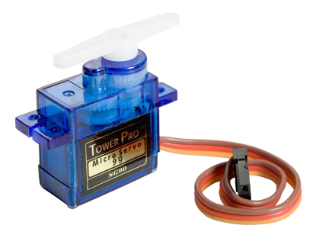
Servos
 | SG90 | SG51R | HS-35HD
Manufacturer | Tower Pro | Tower Pro | Hitec
Size | 23.0 x 12.2 x 29.0 mm | 22.0 x 22.0 x 12.0 mm | 18.6 x 7.6 x 15.5 mm
Rotation Angle | 180 Degree | 180 Degree | 180 Degree
Weight | 9 g | 5 g | 4.5 g
Unit Price | $ 2.38 | $ 5.95 | $ 24.95

Slide 10
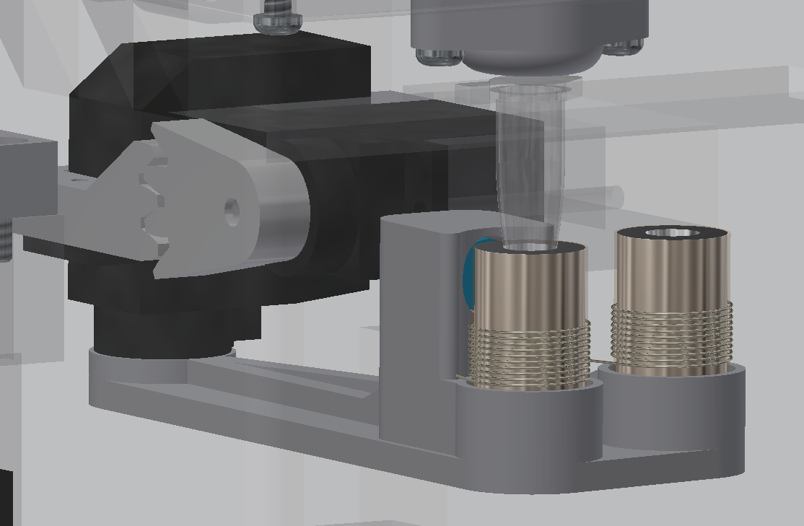
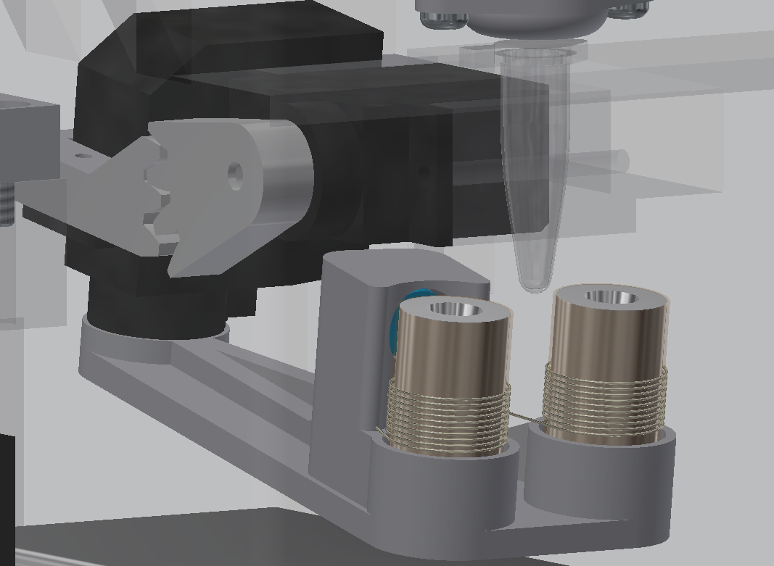
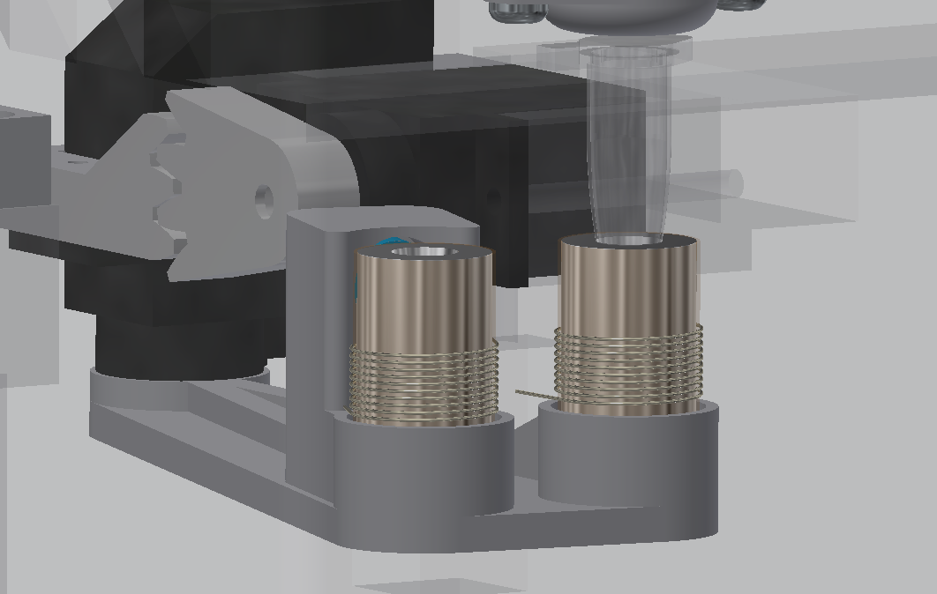
Servo Function
Cooling / Measuring
Moving
Heating

Slide 11
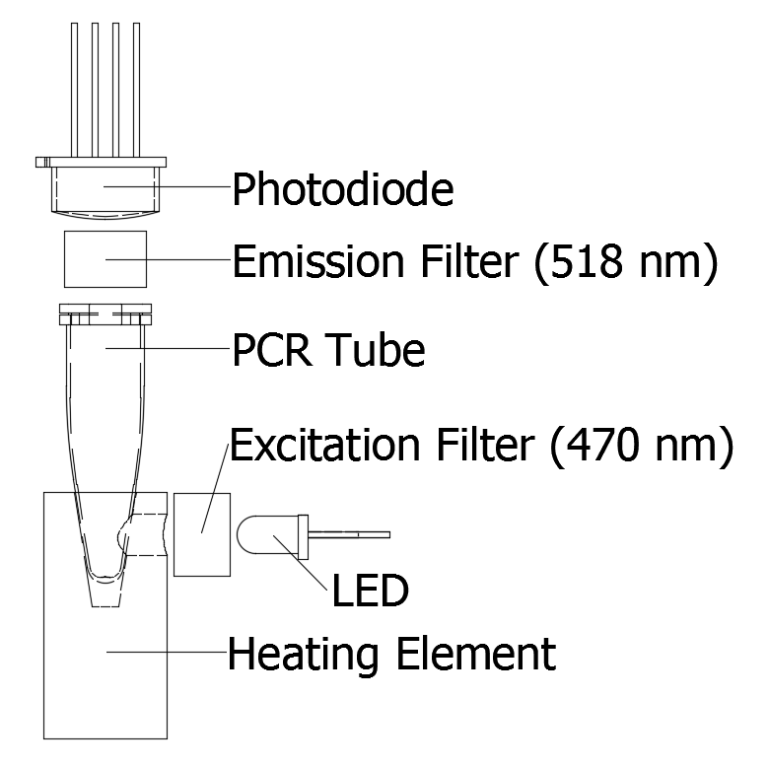
Detection System

Slide 12
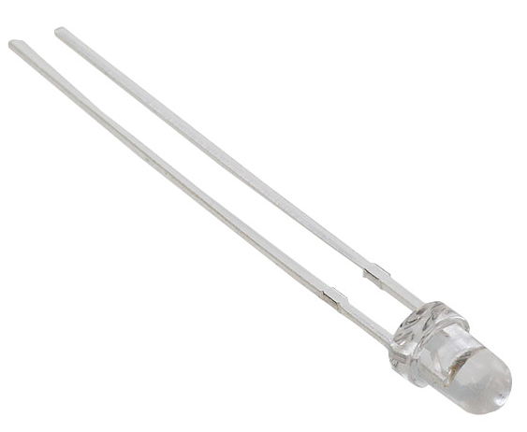
LED
 | MTE4047C5-UB | OD-469L | MTE3047N-UB
Manufacturer | Marktech Optoelectronics | Opto Diode Corp | Marktech Optoelectronics
Size | 3 mm | 9.4 mm | 5mm
Wavelength | 470 nm | 470 nm | 470 nm
Max Current | 30 mA | 350 mA | 50 mA
Unit Price | $ 7.18 | $ 25.13 | $ 11.42

Slide 13
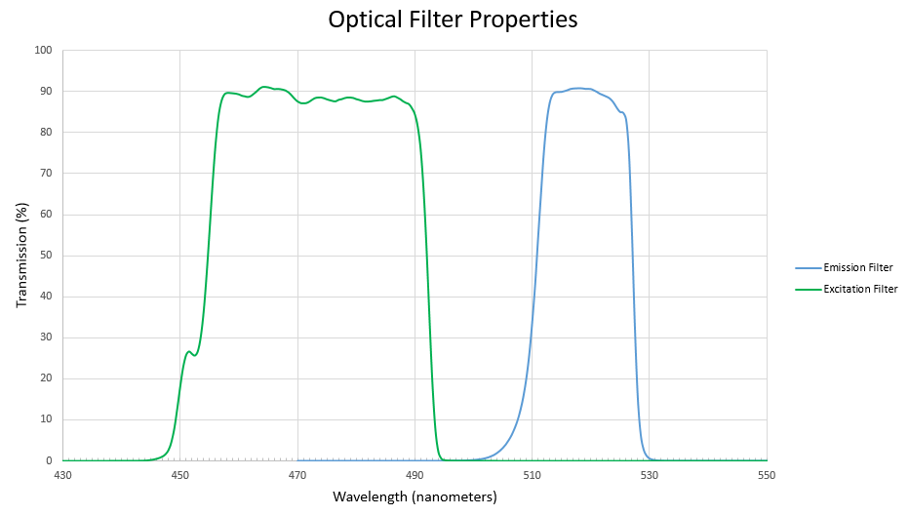
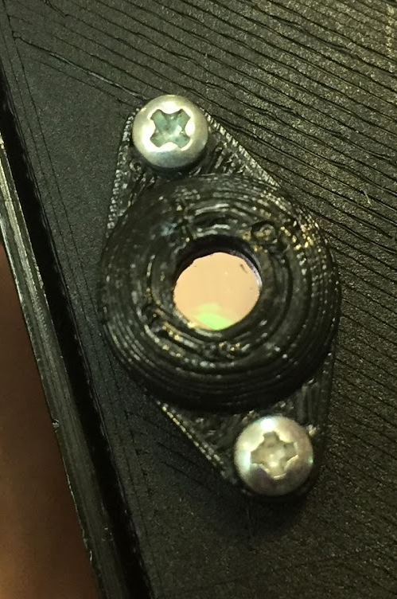
Filters
Emission Filter
Omega W5800
Omega W5798

Slide 14
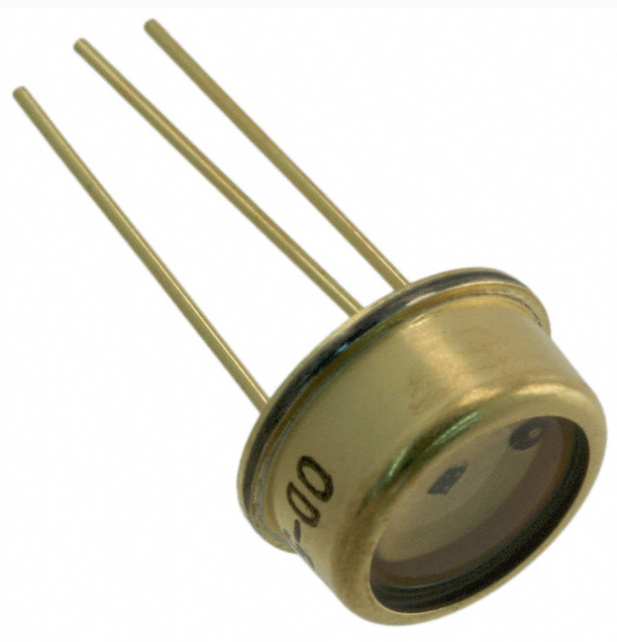
Photodiode
 | ODA-6WB-500M | MTQD5.8PV1-5 | SLD-70BG2A
Manufacturer | Opto Diode Corp | Marktech Optoelectronics | Luna Optoelectronics
Passive / Active | Active | Active | Passive
Gain | 500M | 250M | 0
Enhanced Color | Green | Blue/Green | Blue/Green
Active Area | 6 mm² | 5.7 mm² | 9 mm²
Unit Price | $ 74.42 | $ 24.77 | $ 6.45

Slide 15
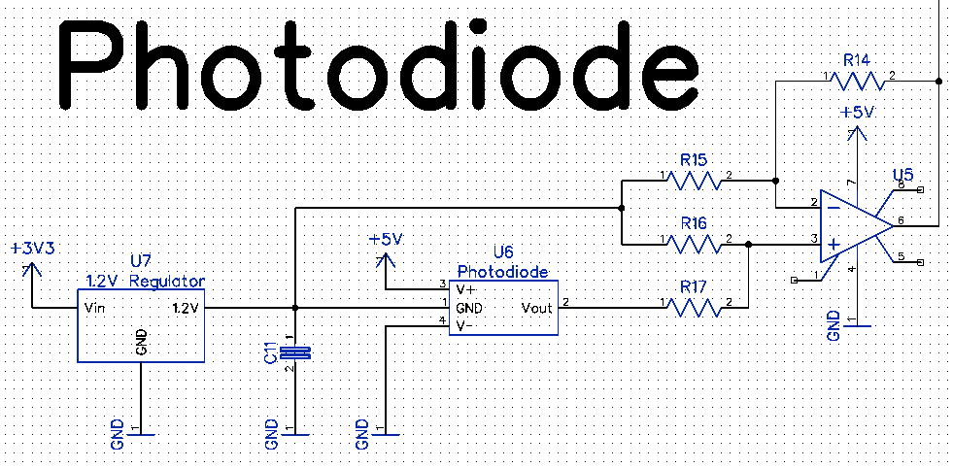

Slide 16
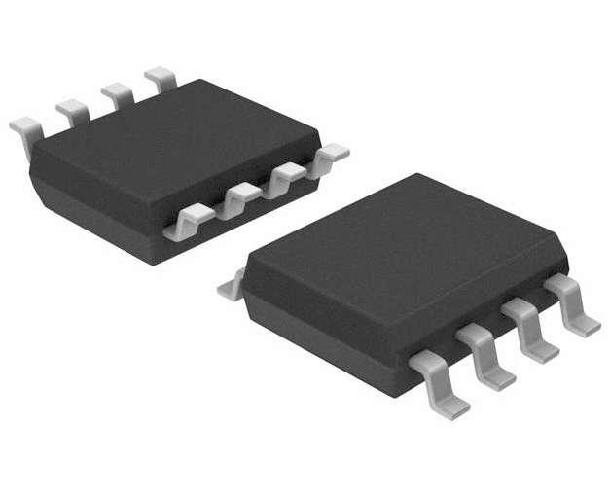
Op-Amp
 | MAX406ACSA+ | OPA317QDBVRQ1 | TSU111IQ1T
SR - Slew Rate: | 20 V/us | 150 mV/us | 2.7 V/ms
Supply Voltage - Min: | 2.5 V | 5.5 V | 5.5 V
Input Voltage Noise Density | 150 nV/sqrt Hz | 55 nV/sqrt Hz | 200 nV/sqrt Hz
Output Type: | Rail to Rail | Rail to Rail | Rail to Rail
Gain Bandwidth Product: | 40 kHz | 300 kHz | 11.5 kHz
Package / Case: | SOIC-8 | SOT-23-5 | DFN-6

Slide 17
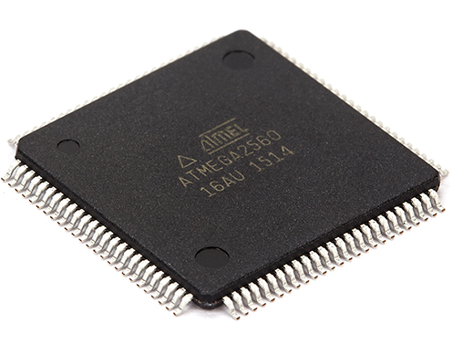
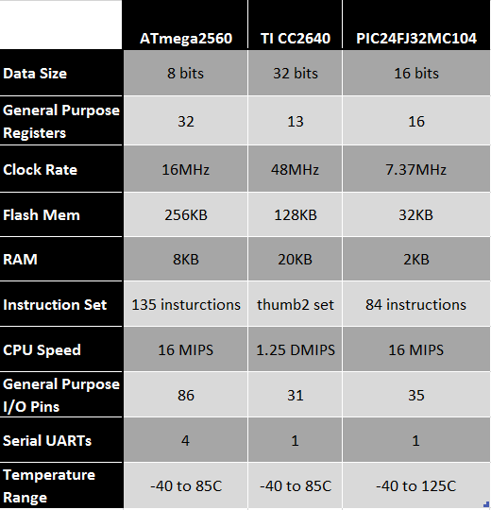
Microcontroller
Atmel ATmega2560
Best MCU for our project.
Reliable
Cost effective
Able to support all features.
Room for more if wanted.
Easy for testing, on Arduino development board with IDE.
Widely supported and large community.

Slide 18
Microcontroller
Needed variety of pins to accommodate our features.
3 Serial Ports and a variety of I/O pins.
General Purpose I/O
Display
Heaters
LED
Battery Charging Stat
Low Battery Indicator
Servos (PWM)
Serial
GPS
Bluetooth
Debug Port
Analog
Temperature Sensors
Photodiode
Battery Level

Slide 19
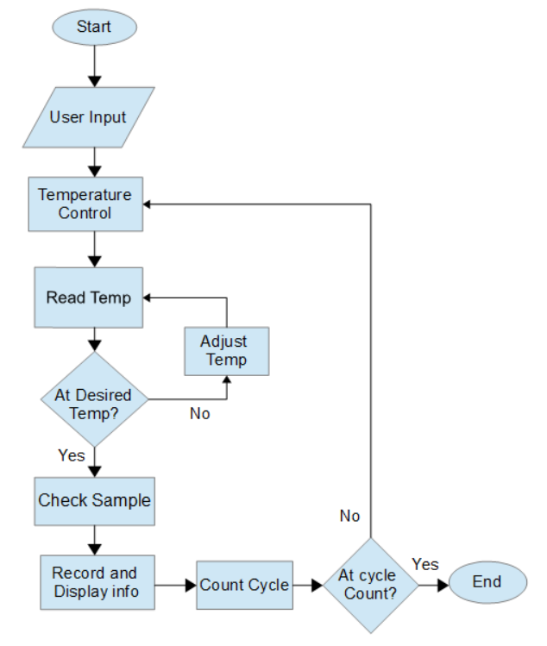
Microcontroller

Slide 20
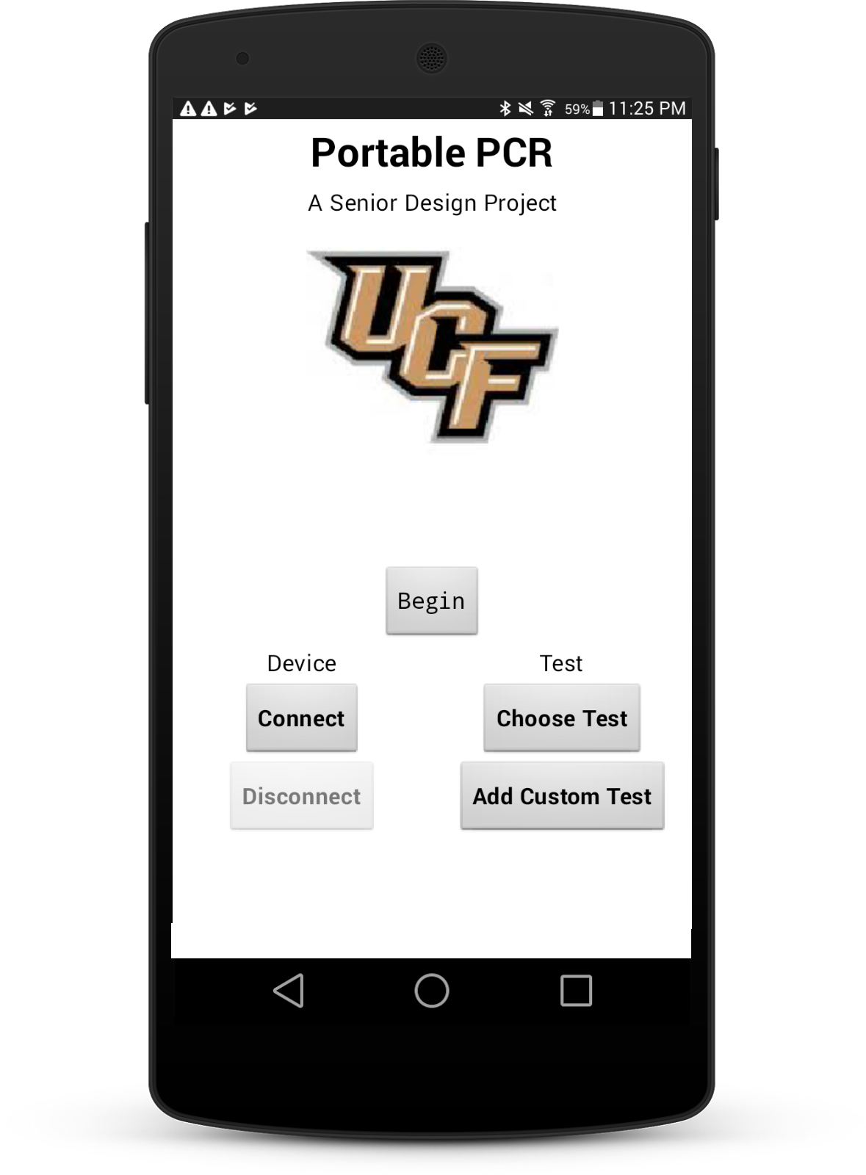

Application
Decided on Android for cheaper development and wide use.
Developed using the android studio IDE.
Testing on a Samsung android tablet and Galaxy S

Slide 21
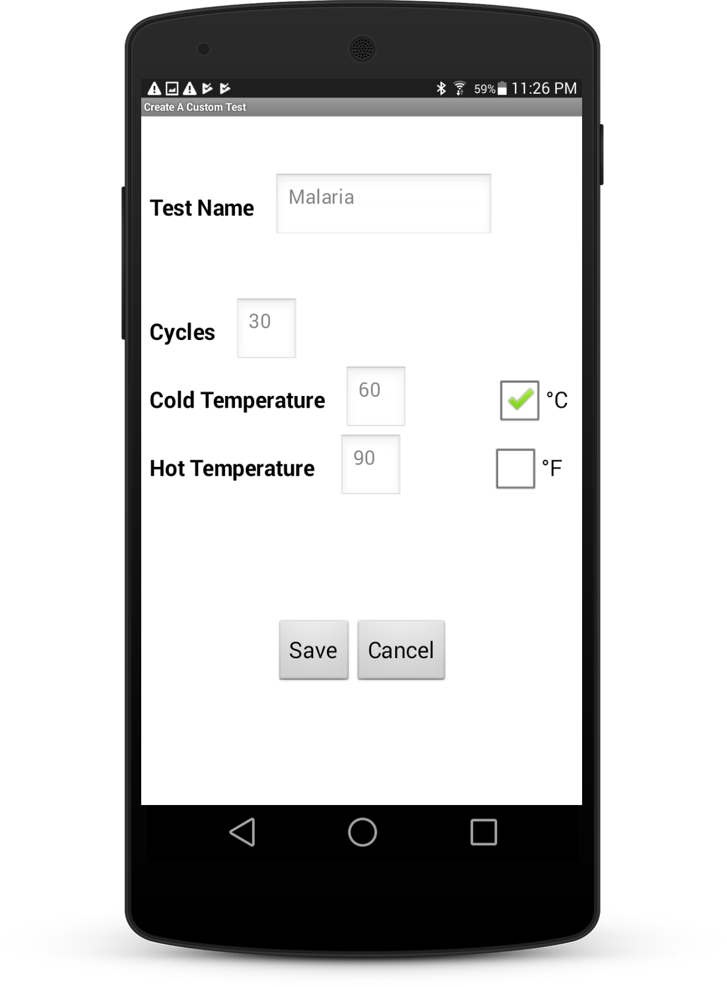
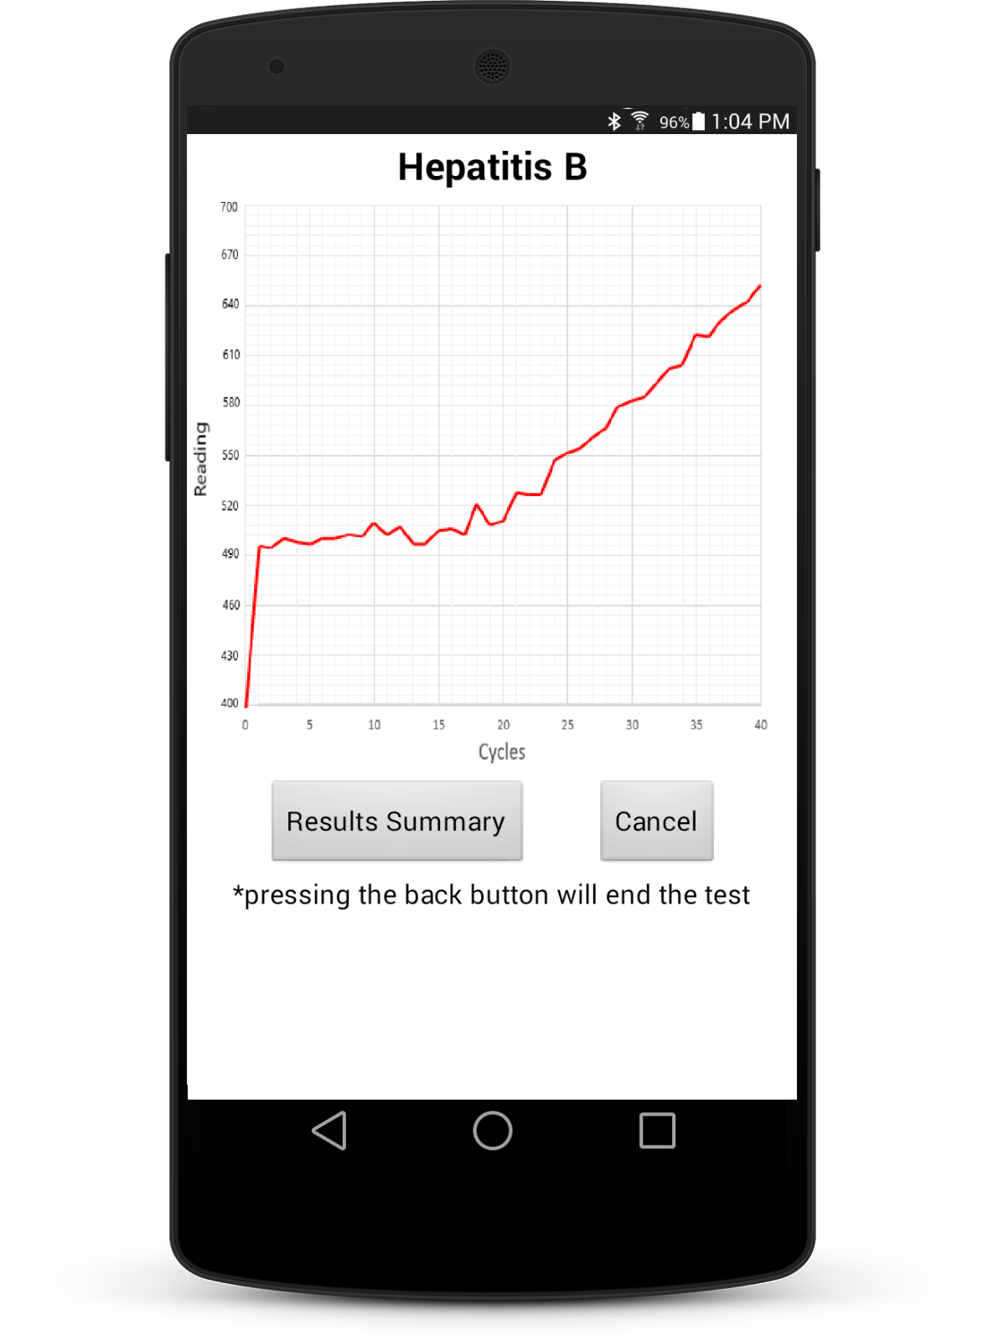
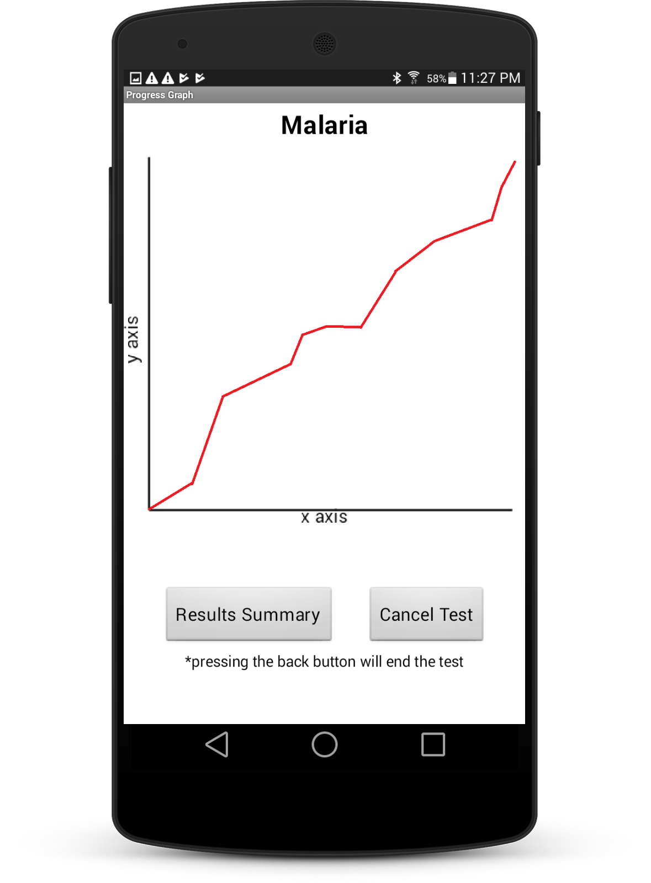
Application
Four simple screens that progress in a linear sequence.
Main Start Screen
Custom Test Screen
Test Running Screen
Result/Submission Page

Slide 22
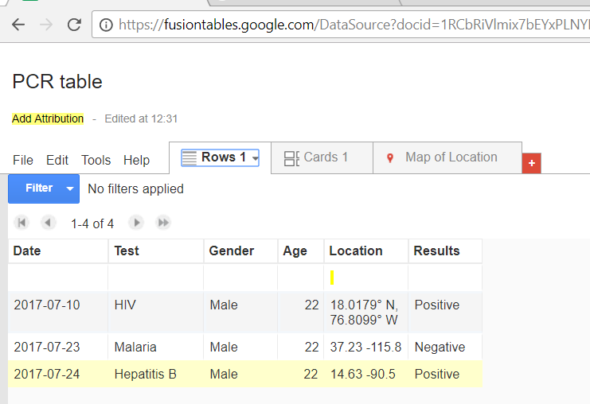
Database
Google Fusion Tables
Much like an excel spreadsheet
Rows can be added by anyone
Only Registered Viewers can see the table

Slide 23
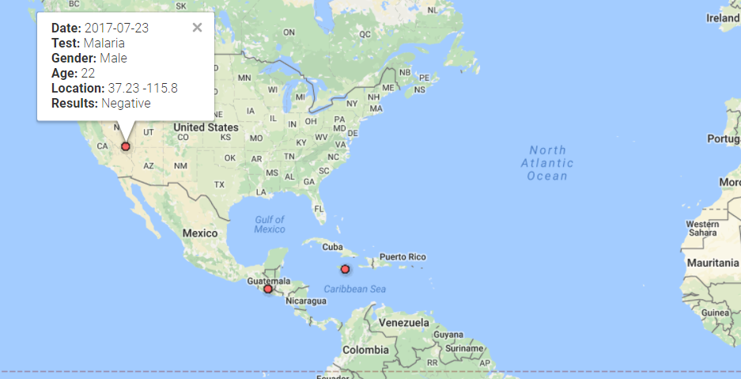
Database
Locations can even be mapped for quick trend views

Slide 24
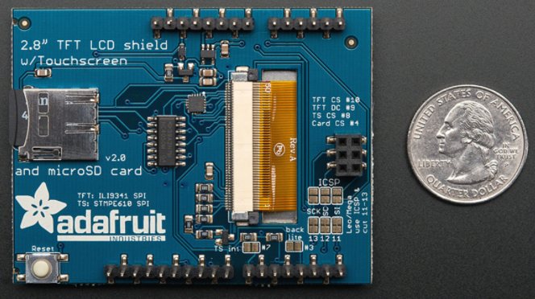
Display
 | Adafruit TFT Touch Shield v2 | Capacitive | Resistive
Voltage Compatibility | Up to 3.3V | Up to 3.3V | Up to 5V
Pins | 13 | 13 | 12
Color | 18-bit | 18-bit | 8-bit
Resolution (pixels) | 240x320 | 240x320 | 240x320
Size (Diagonal) | 2.8” | 2.8” | 2.8”

Slide 25
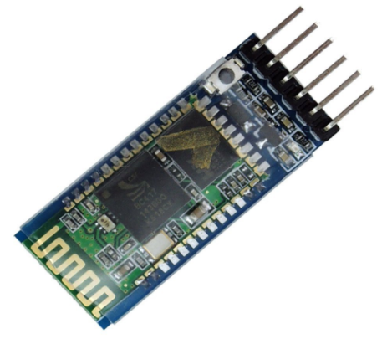
Bluetooth
 | HC - 05 | CC2564 | XS3868
Power supply: | 1.8 - 3.6V | 3.0 - 3.6V | 3.6 - 4.2V
Range: | 10 meters | 10 meters | 10 meters
UART Baud Rate: | 9600~460800bps | 2400~460800bps | 115200bps
Size: | 12.7mmx27mm | 76.2mmx25.4mm | 35mmx15mm
Bluetooth | V2.0+EDR | 4.1(BR/EDR, BLE) | V2.0
Cost | $7.99 | $14.99 | $8.29

Slide 26
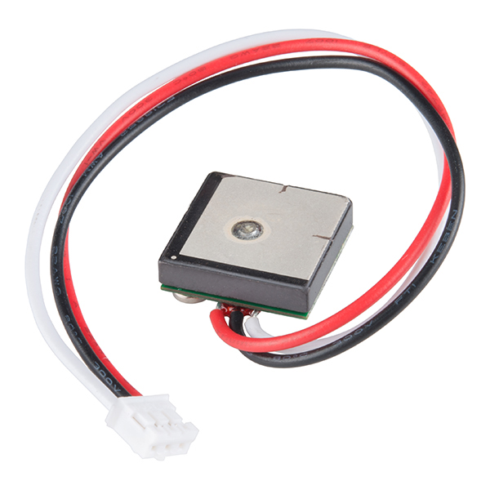
GPS
 | NEO-6M | NEO-7M-C | FeatherWing | GP-20U7
Channels: | 50 Channels | 56 Channels | 66 Channels | 56 Channels
Power Supply: | 3.6 V | 3.6 V | 3.6 V | 3.3 V
Sensitivity | -161dBm | -161 dBm | -145 dBm | -162 dBm
Position Accuracy | 2.5 meters | 2.5 meters | 3 meters | 2.5 meters
Acquisition time (Cold Start) | 27 seconds | 30 seconds | 34 seconds | 29 seconds
Size: | 16.0 x 12.2 x 2.4 mm | 16.0 x 12.2 x 2.4 mm | 22.9 x 51.2 x 6.7 mm | 18.4 x 18.4 x 4 mm
Cost: | $20.99 | $33.32 | $29.50 | $15.95

Slide 27
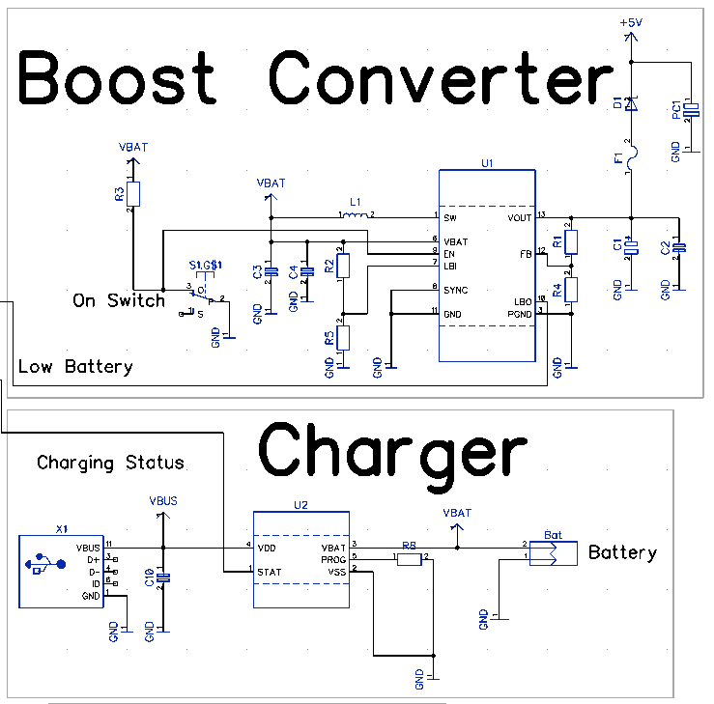
Power
Fourth member responsible for the power supply, charging systems, and PCB layout left the group.
Parts used:
Boost Converter:
TI TPS61030
Charger:
Microchip MCP73831

Slide 28
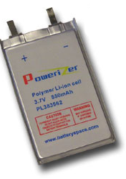
Batteries
 | Li-ion Polymer Flat Pack | 18650 | AA
Make | Battery Space | Panasonic | Duracell
Voltage | 3.7 V | 3.6 V | 1.5V
Capacity | 850 mAh | 3400 mAh | 2400 mAh
Size | 3.3 mm x 35 mm x 62 mm | 18 mm x 65 mm | 14.5 mm x 50 mm
Cost | $5.95 | $15.00 | $0.54
Rechargeable? | Yes | Yes | No

Slide 29
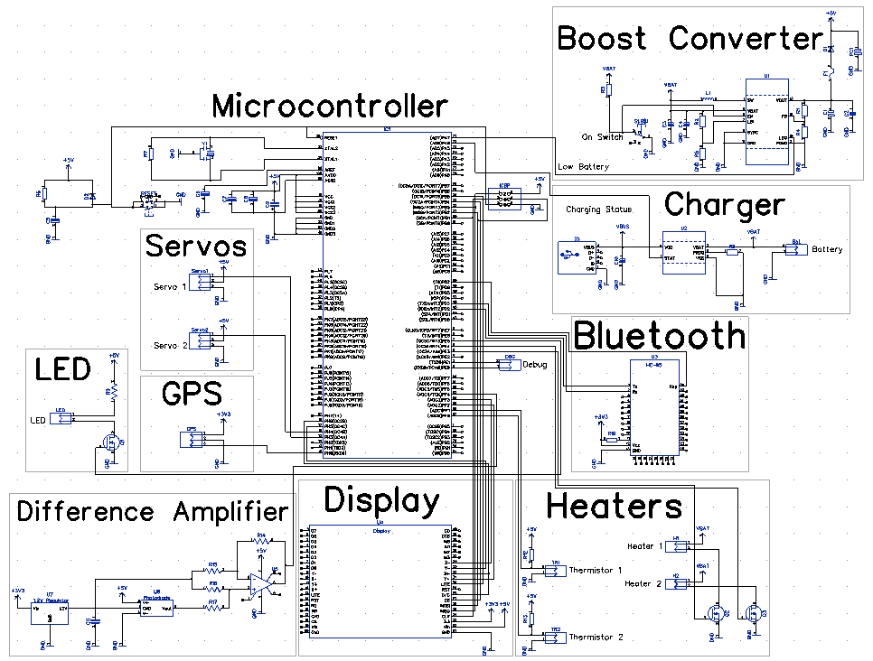
Overall Schematic

Slide 30
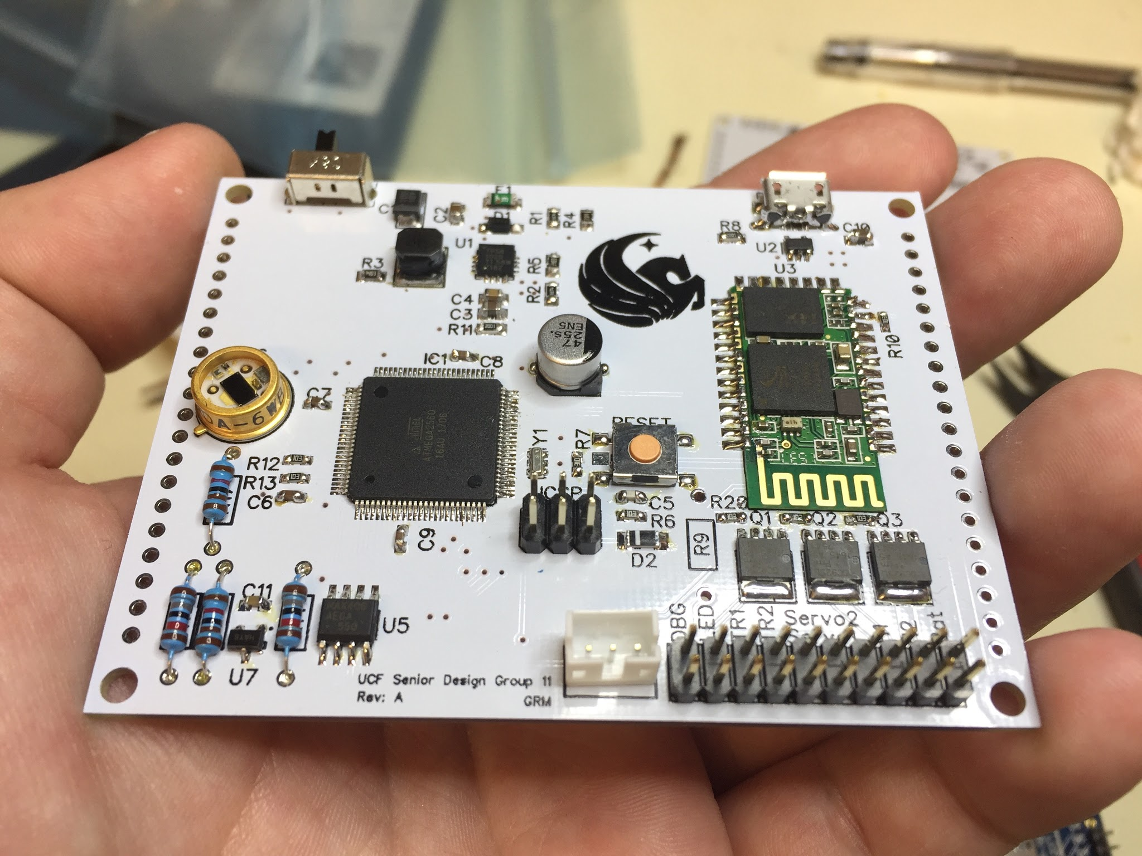
PCB
Designed using DipTrace
Fabricated by PCB Way

Slide 31
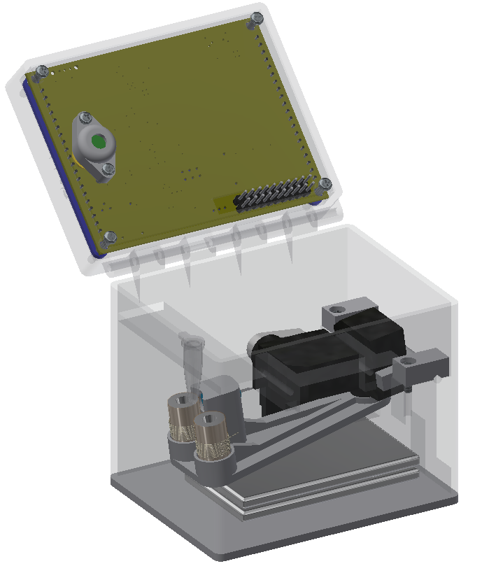
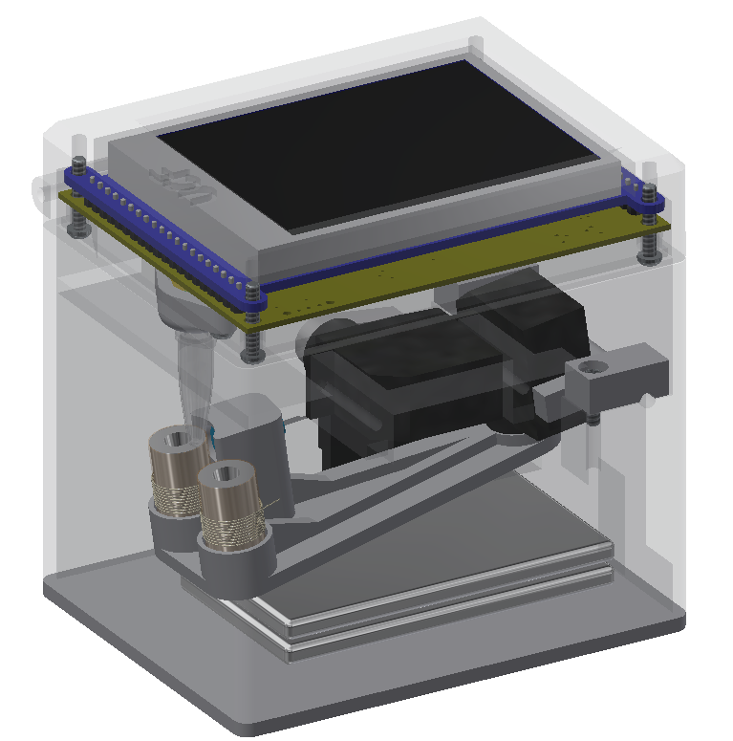
3D CAD
Closed
Open

Slide 32
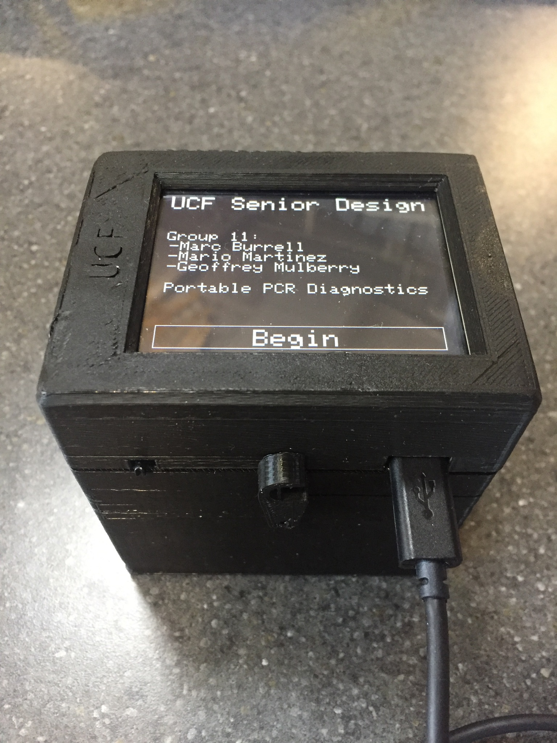
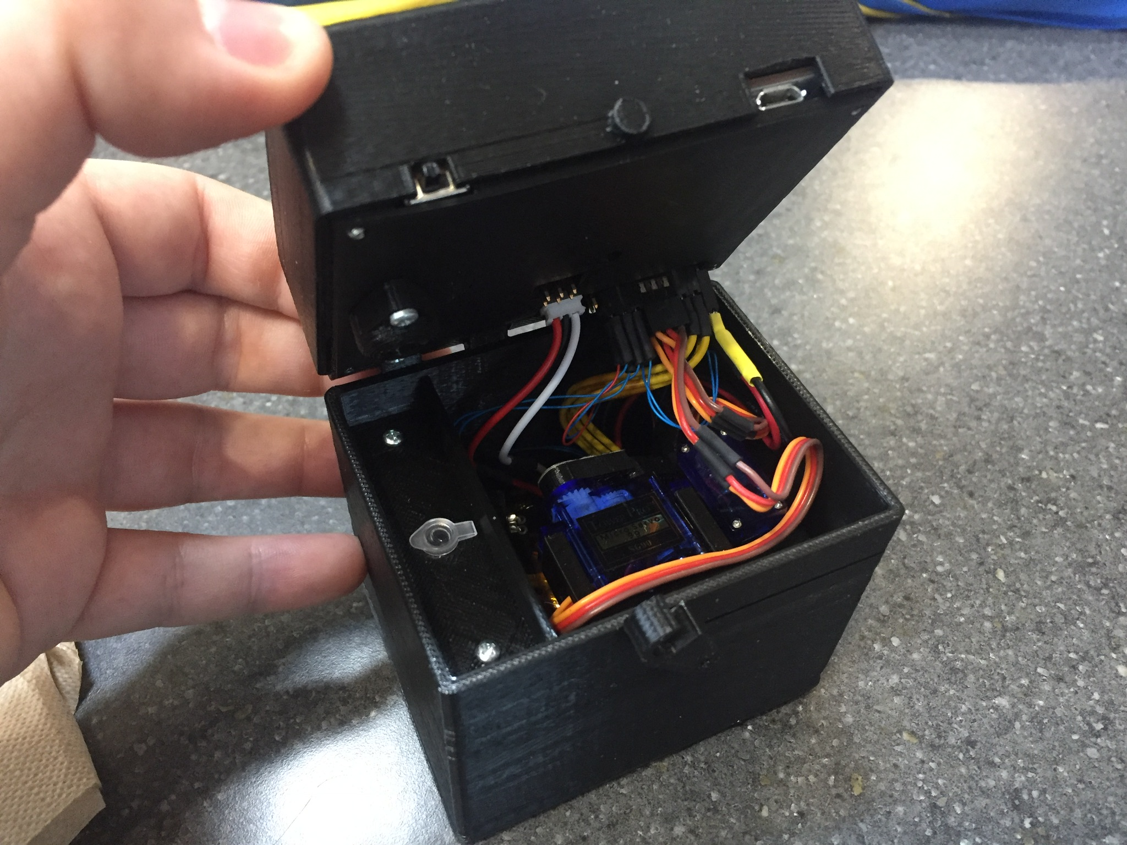
Final Product

Slide 33
Possible Improvements
Redesign power supply for battery-only operation
Improve cable management
Allow app full control over PCR device

Slide 34
Budget
Item | Budget | Price Spent | Suppliers
Display | $50 | $29.95 | Adafruit
Electronic Components | $200 | $167.71 | DigiKey
Bluetooth Module | $20 | $7.99 | Amazon
GPS Module | $20 | $19.95 | Amazon
Batteries | $20 | $11.90 | BatterySpace
Mechanical Components | $100 | $82.47 | Amazon, Omega Optical
PCB | $60 | $28.00 | PCB Way
Total | $500 | $347.97
Our Total Budget for our Design is:
$500
As of now we have spent $347.97 and still have extra
We are sponsored by Dr. Kim and all expenses are covered by Dr. Kim

Slide 35
Questions

